Slide 2
Outline

Slide 3
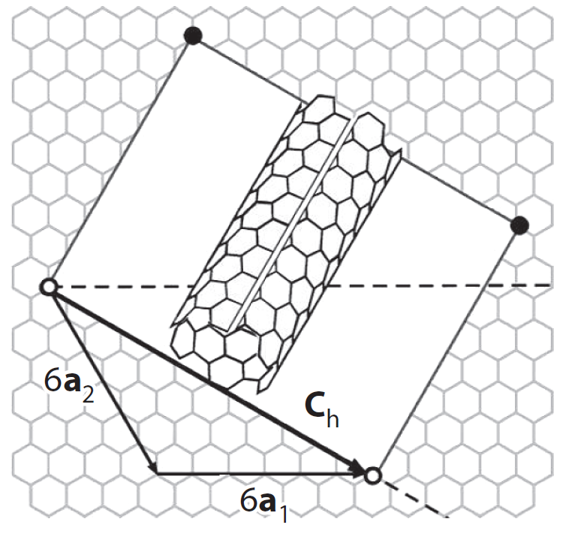
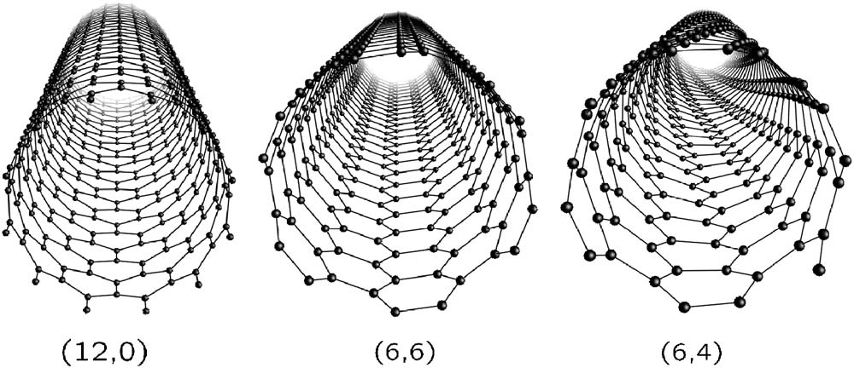
Carbon nanotubes can be visualized as rolled up sheets of graphene.

Slide 4
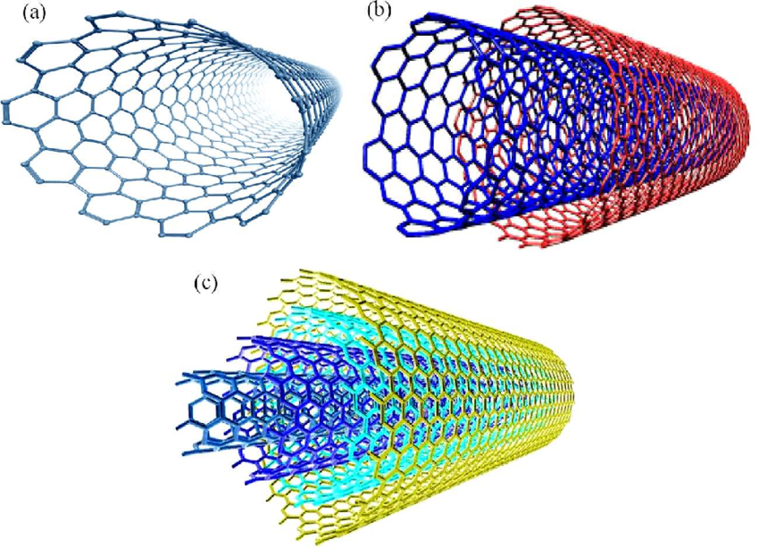
While there are many different types of nanotube structures, this thesis focuses solely on single-wall carbon nanotubes (SWCNTs).

Slide 5
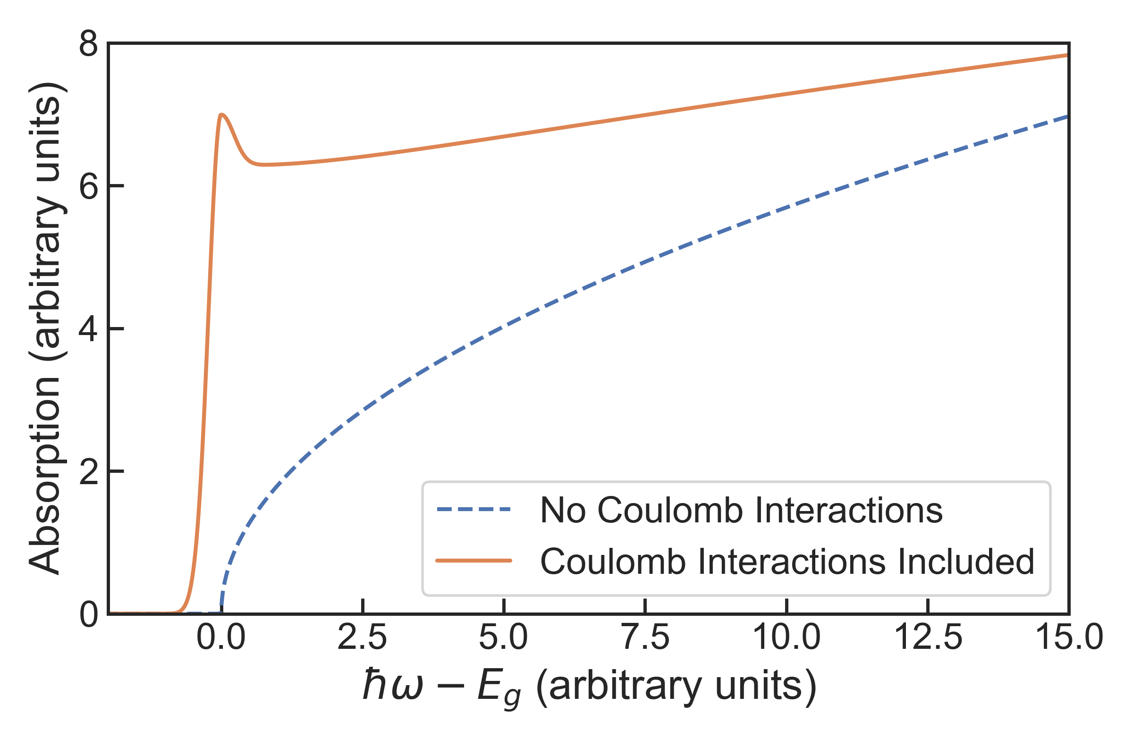
For 3-D materials, the Sommerfeld factor enhances interband absorption.

Slide 6
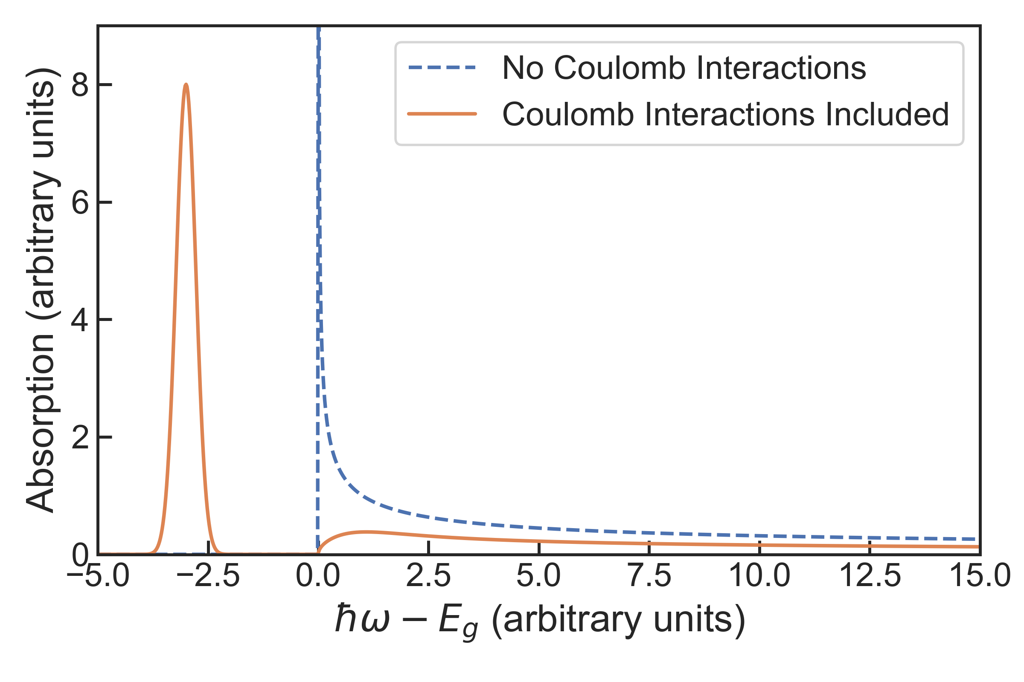
However, for 1-D materials, the Sommerfeld factor suppresses optical absorption of interband states.

Slide 7
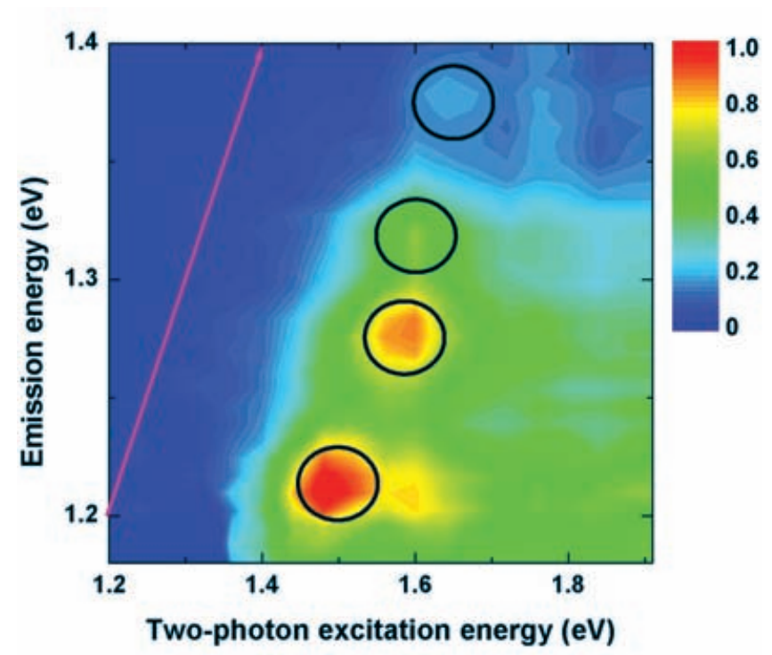
Exciton binding energies in SWCNTs can be on the order of hundreds of meV.
Show binding energies of SWCNTs

Slide 8
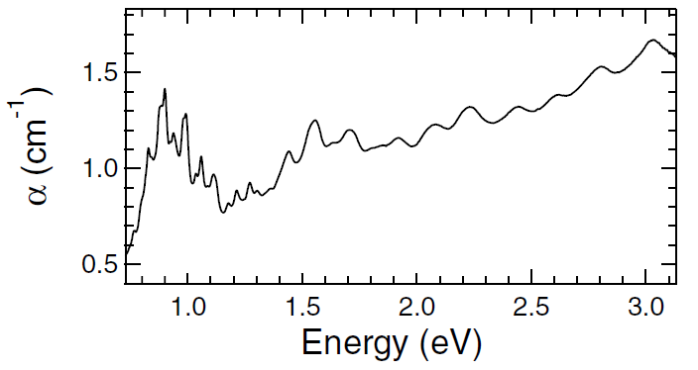
In the past, sample preparation techniques were only capable of making SWCNT suspensiosn with many different chiralities.

Slide 9
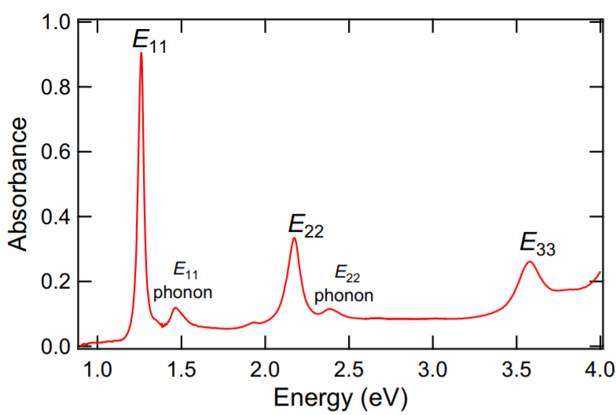

Slide 10
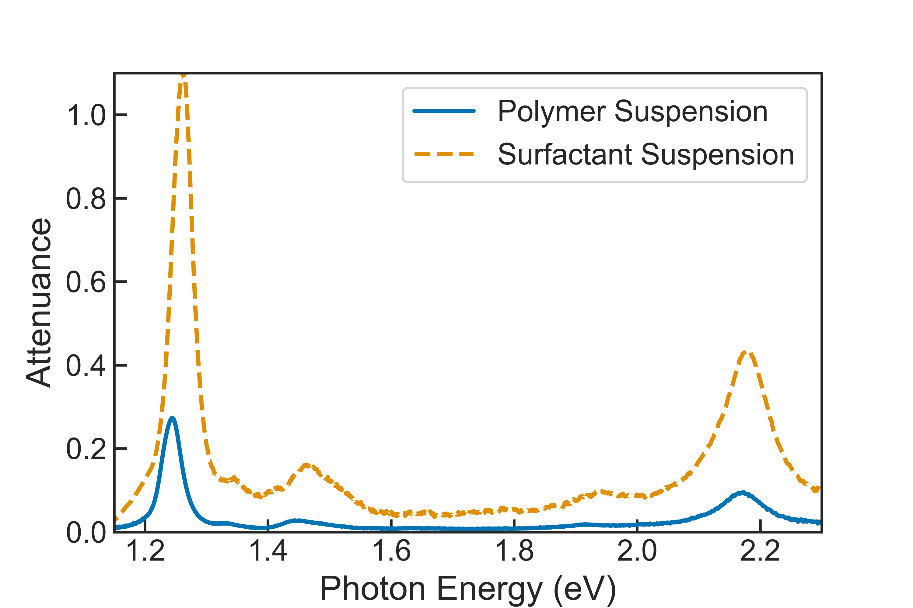
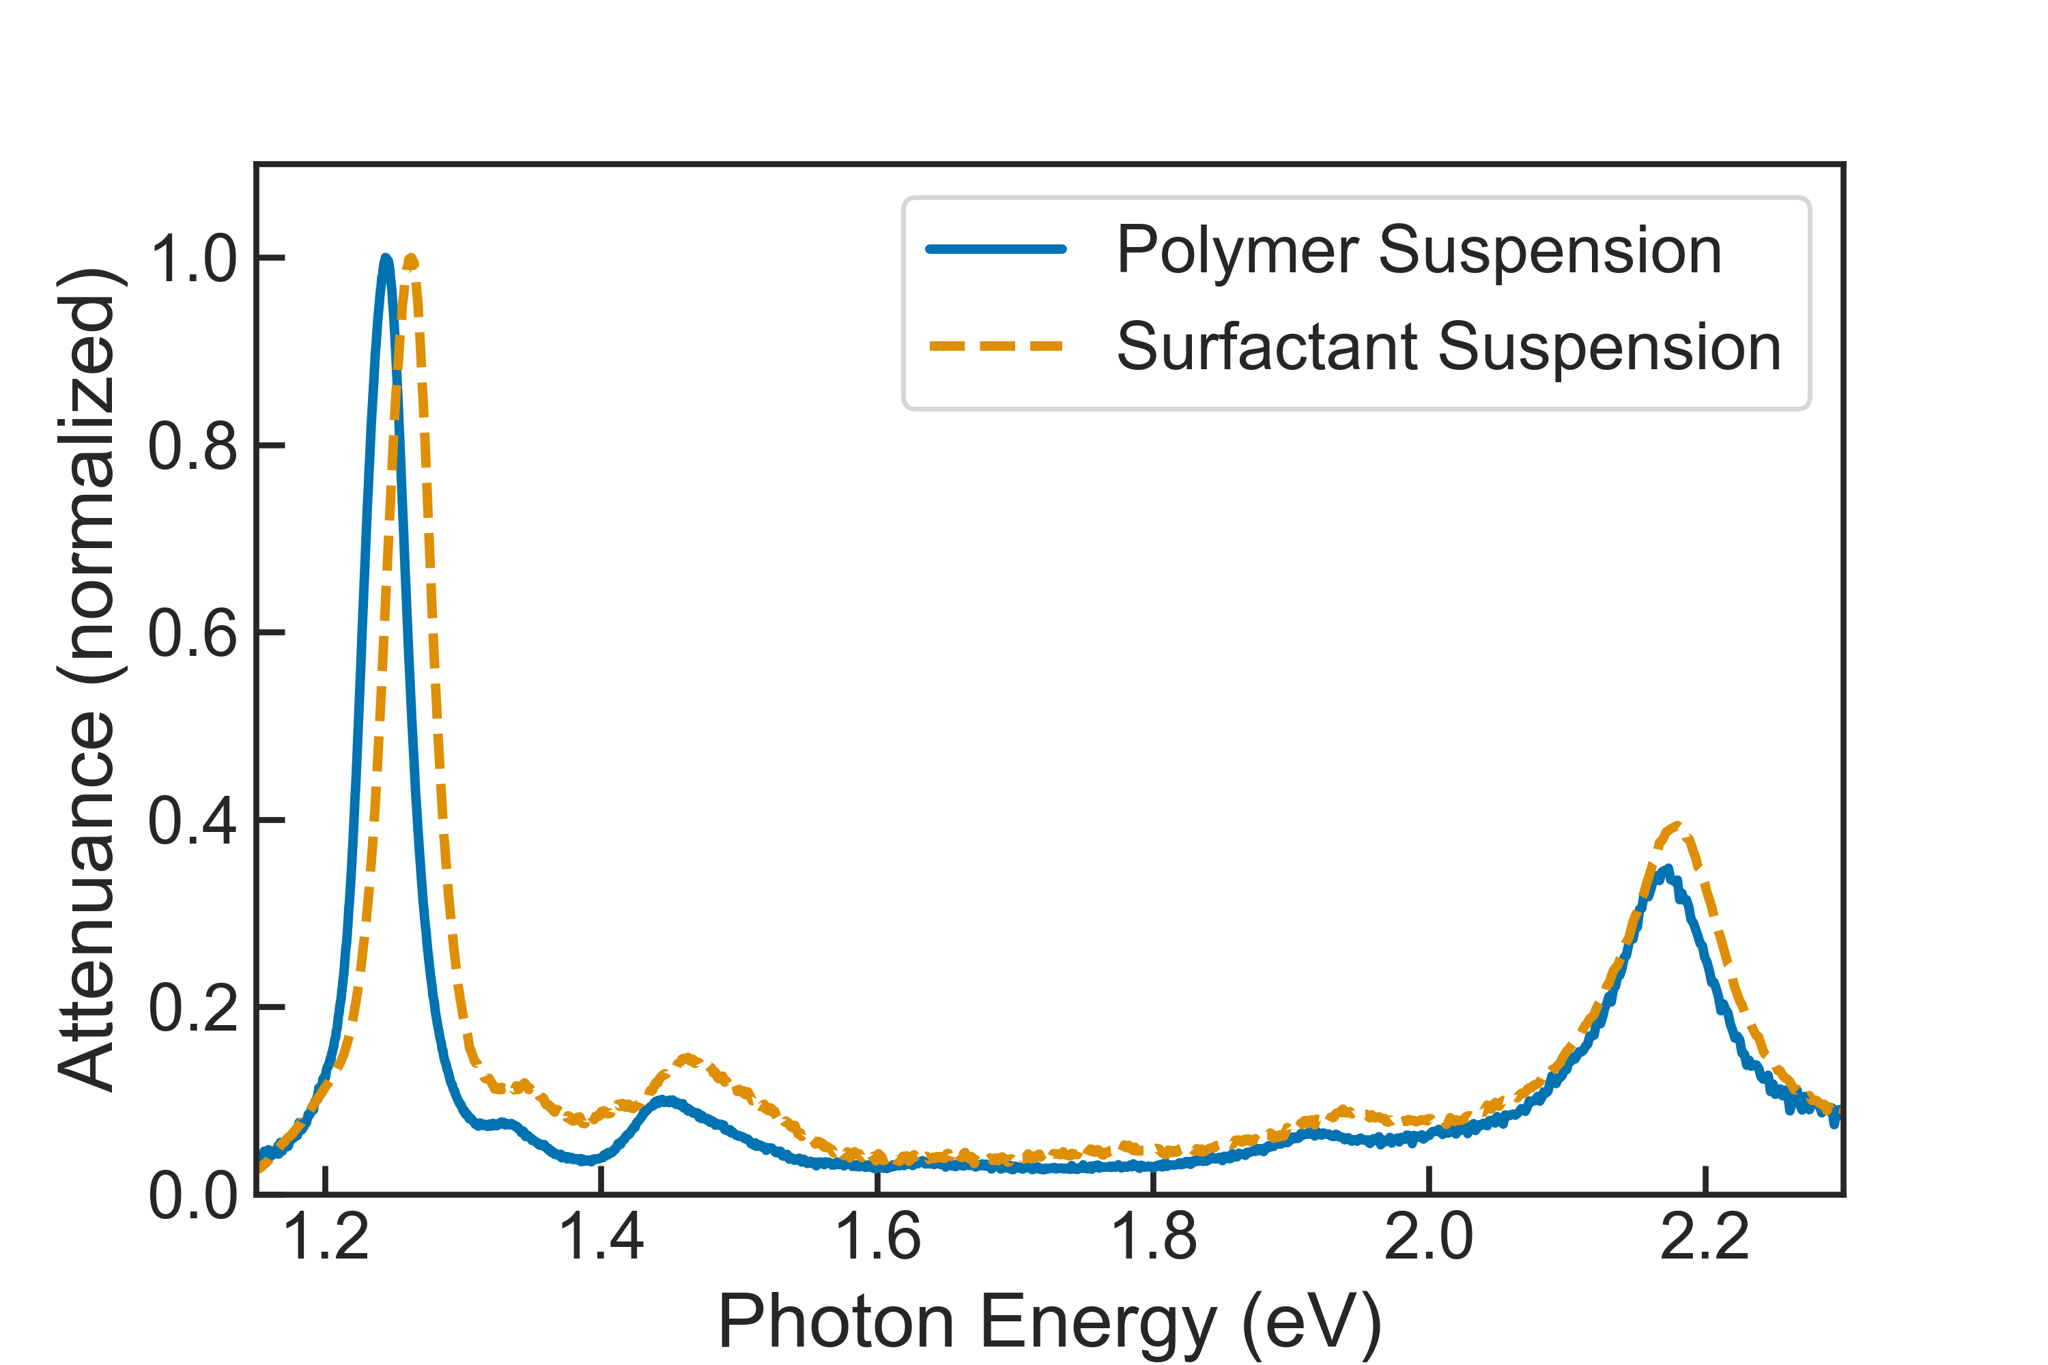
However, modern techniques have made single-chirality enriched samples more accessible.

Slide 11
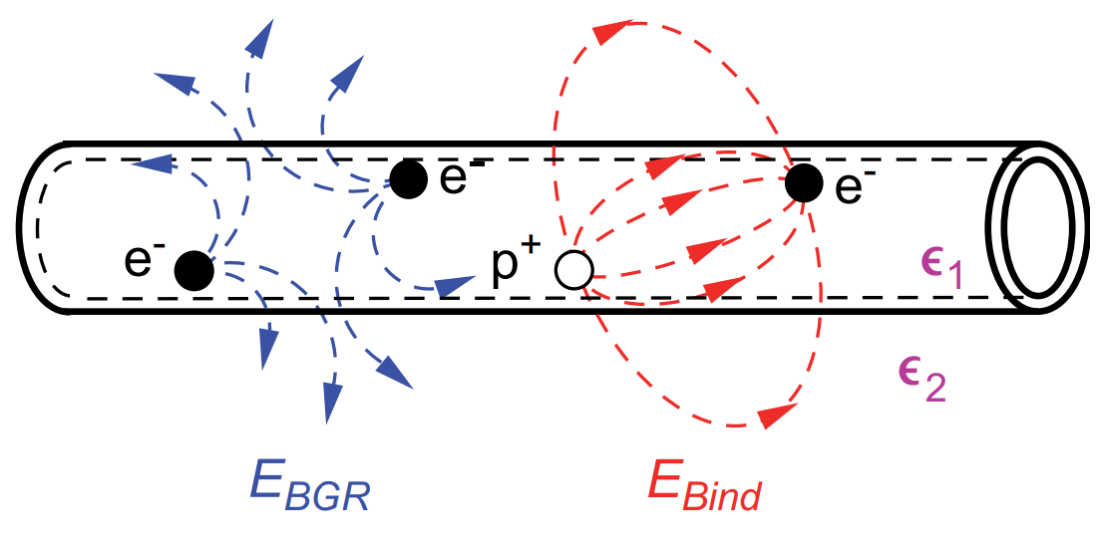
Screening of Coulomb interactions in SWCNTs by an external dielectric can affect bang gap renormalization and the binding energies of excitons.

Slide 12
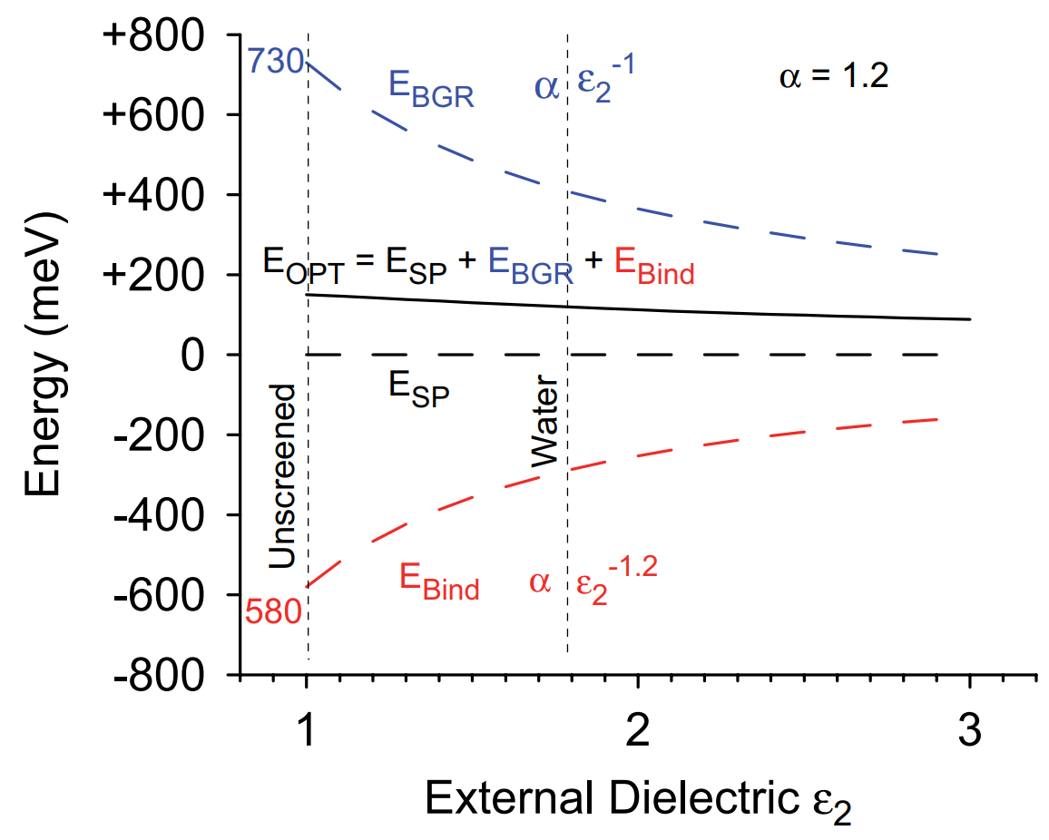
As a result of the screening induced by the external dielectric, optical resonances can redshift as the dielectric constant increases.

Slide 13
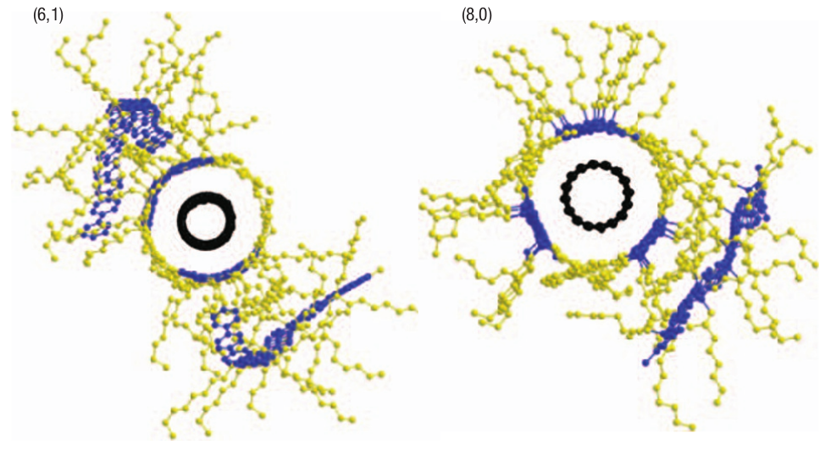
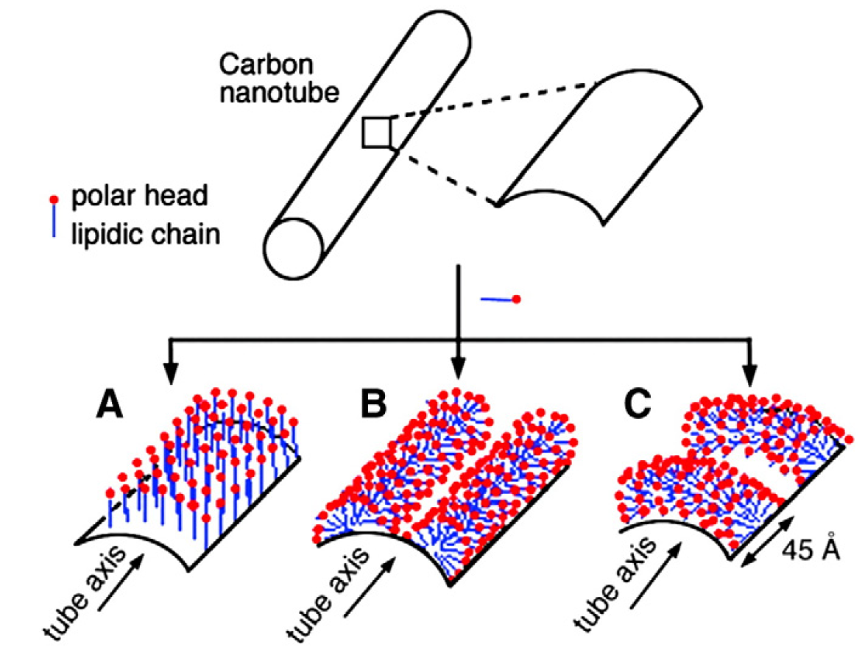
For both samples, the SWCNTs were suspended using either the polymer PFO-Bpy or the surfactant sodium deoxycholate.

Slide 14
Schematic Diagram of the Experimental Apparatus
Optical Fiber
Spectrometer
Wavelength
Separator
Optical Parametric Amplifier
Delay
Stage
Sample
Laser
Optical Shutter
Neutral
Density Filter
Sapphire
Lens
White Light
Continuum

Slide 15
Slide showing what I’m going to talk about in next two slides

Slide 16
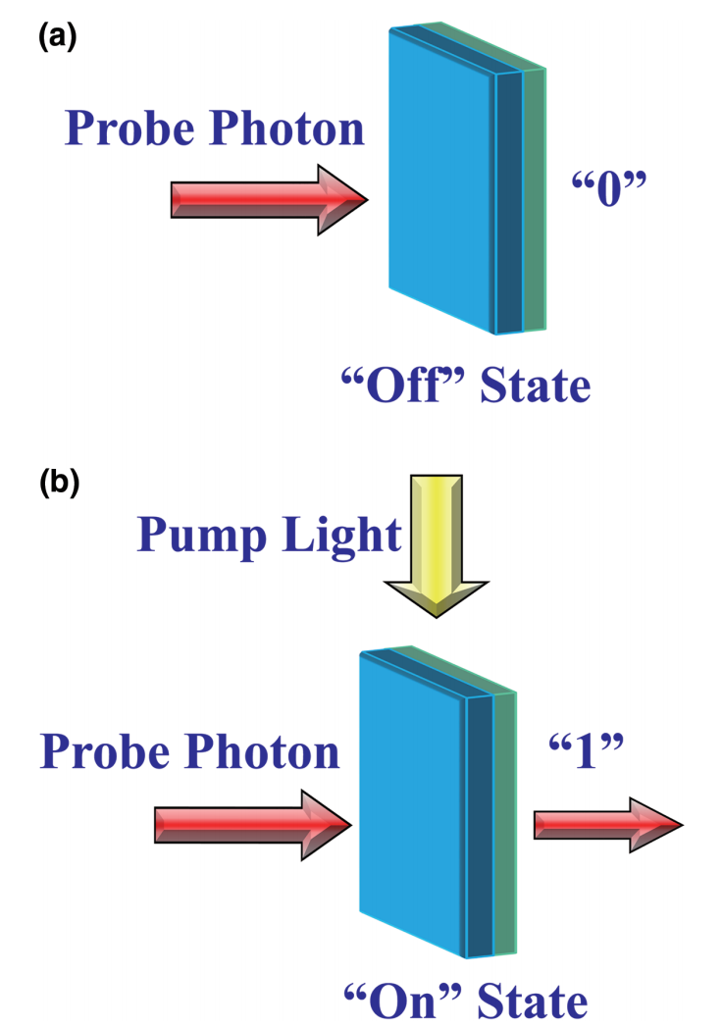
Ultrafast all-optical switching devices harness nonlinear optical phenomena as a switch mechanism.

Slide 17
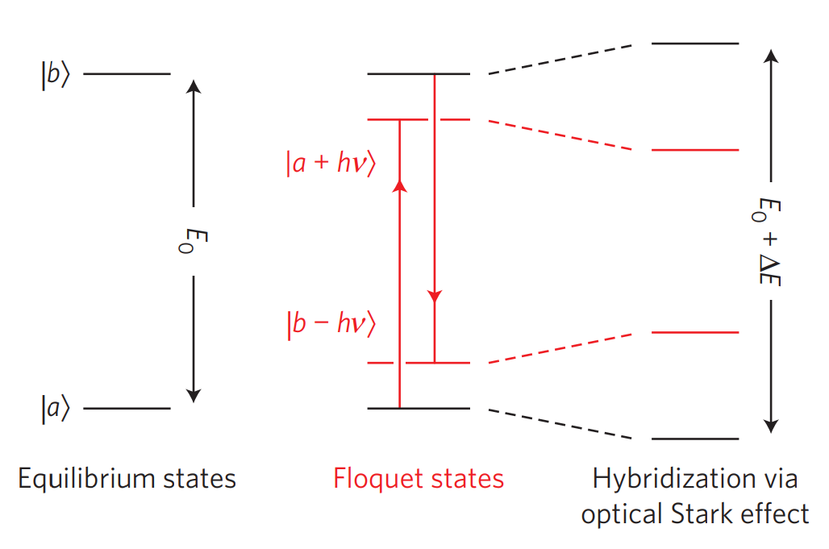
The optical Stark effect can be utilized in the designs of optical switching devices.
Optical
Pump

Slide 18
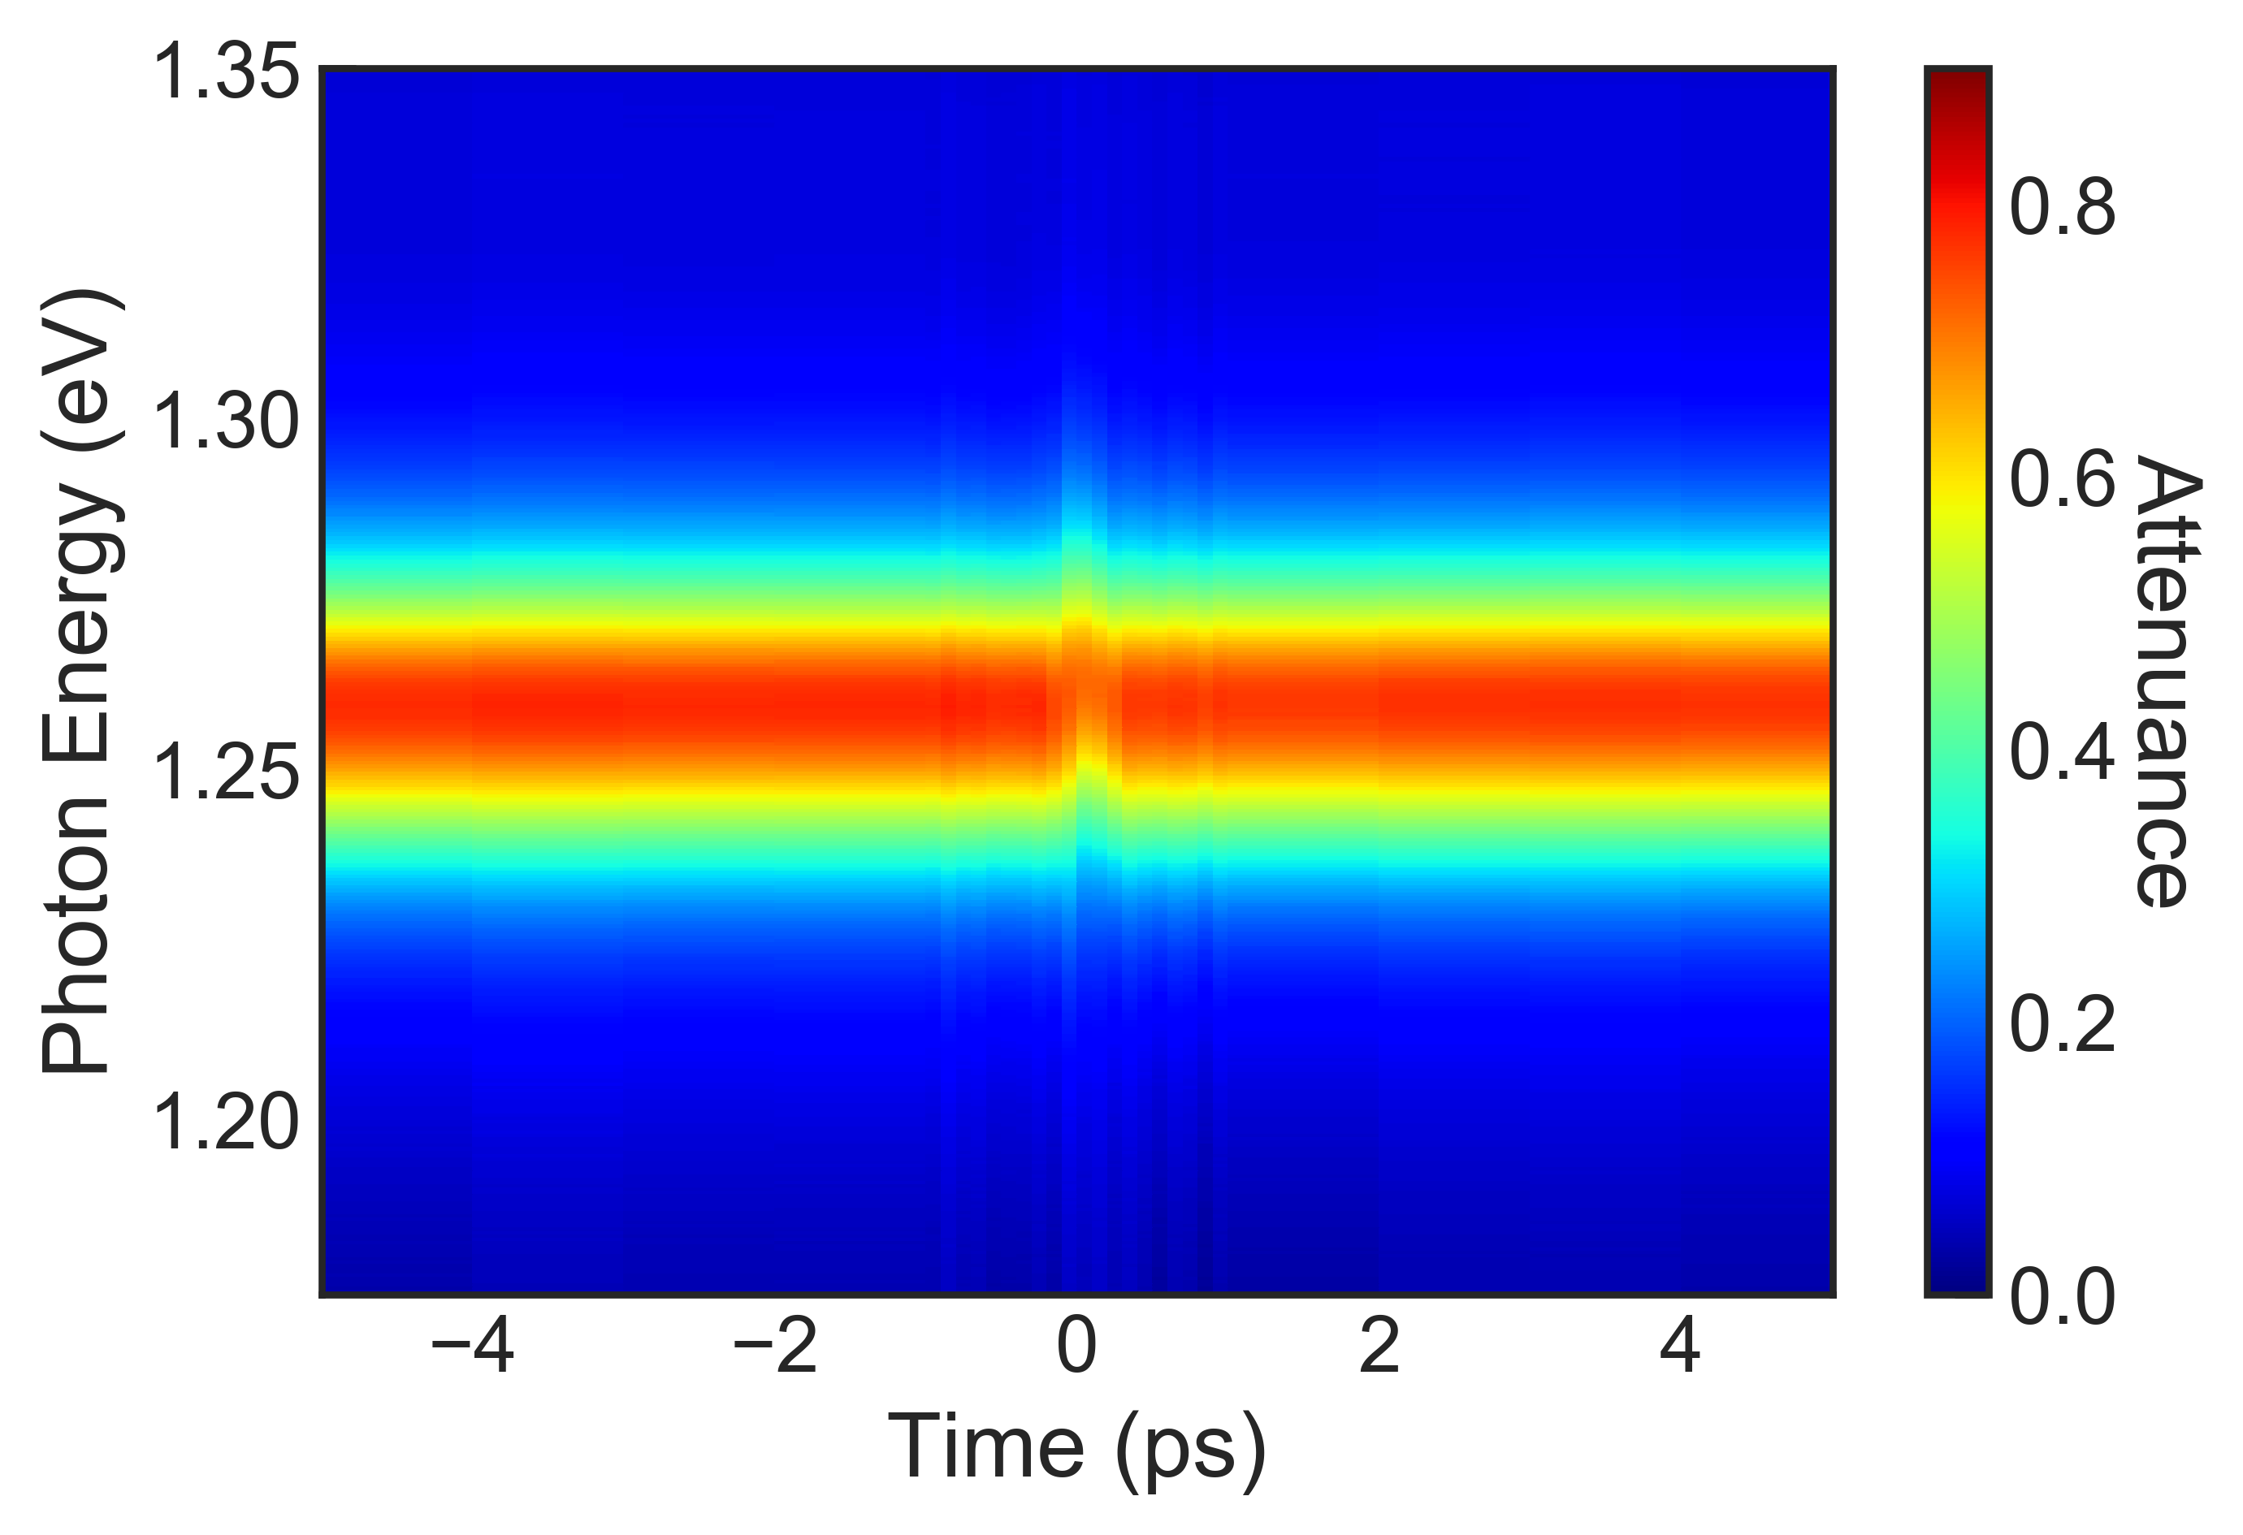
We observed a clear signature of the optical Stark effect in (6,5) SWCNTs.

Slide 19
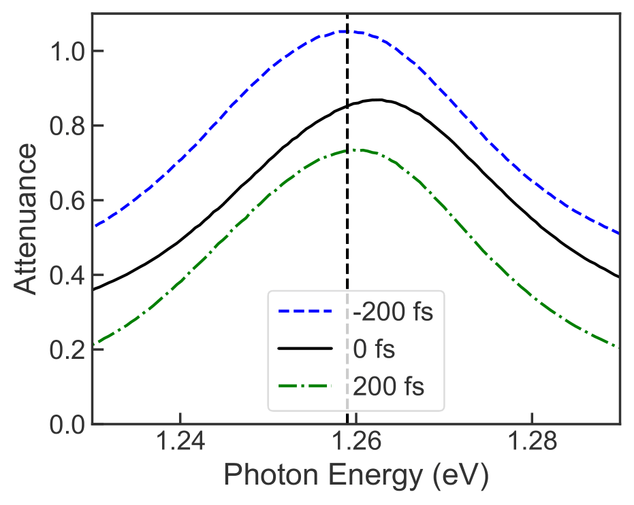
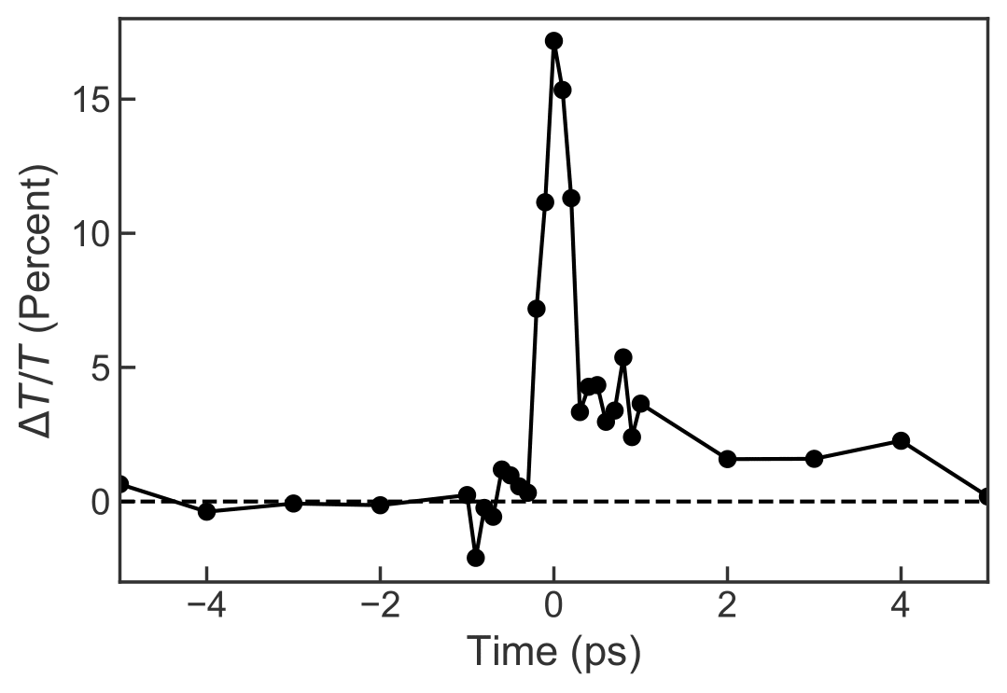
A coherent blueshift of the E11 resonance occurred. We also observed a residual signal due to the creation of excitons via multi-photon processes.

Slide 20
Two ways to describe the dephasing dynamics of the system include a phenomenological model and a quantum-kinetic approach that involves quantum memory.

Slide 21
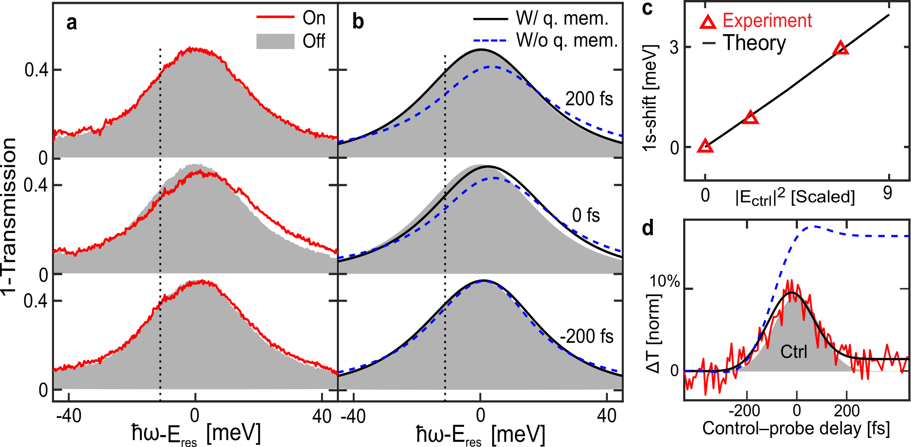
The simulations including quantum memory best reproduced our data.

Slide 22
The observed blueshift appropriately scales with the intensity of the optical pump.

Slide 23
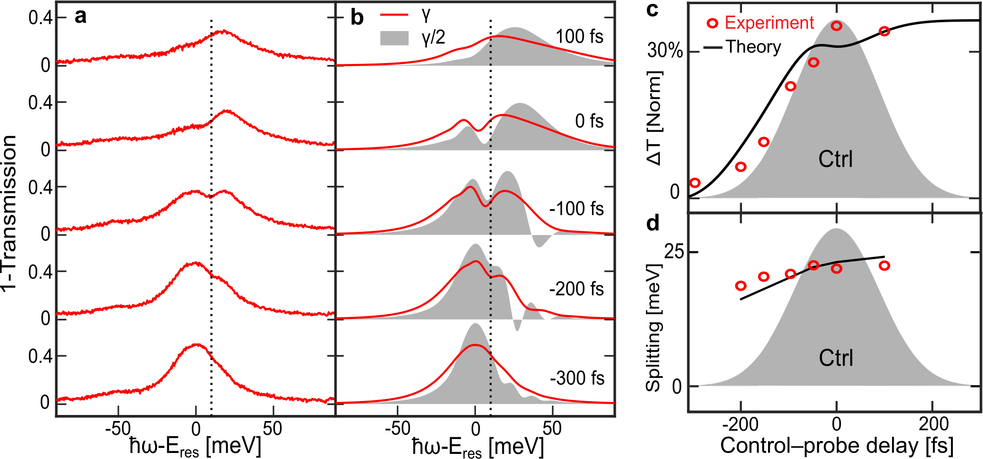
In resonantly exciting the E11 resonance, we observed spectral ringing due to interference between the pump and probe photons.

Slide 24
Transition/Summary Slide

Slide 25
Desire to make other optoelectronic devices like lasers. Is population inversion possible?

Slide 26
Slide on Exciton Mott Transition

Slide 27
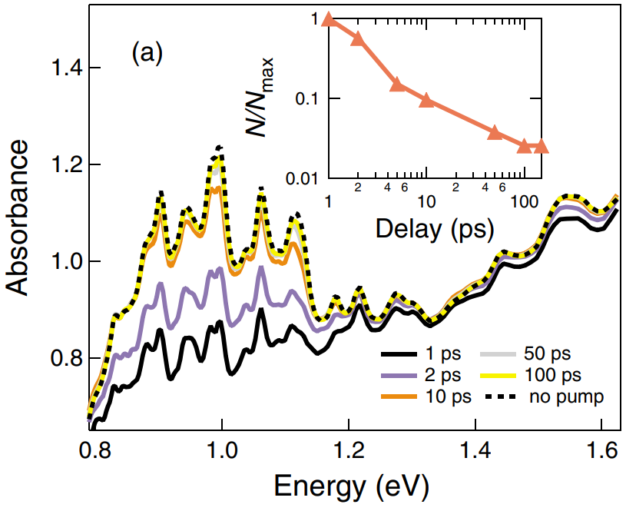
This was first investigated by Ostojic et al who were not able to observe quenching of excitonic resonances in their SWCNT suspension.

Slide 28
Slide on what is exciton-exciton annihilation

Slide 29
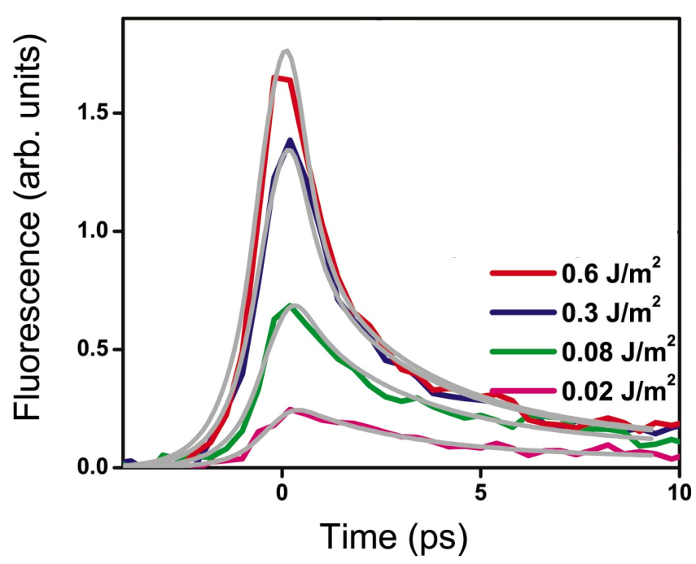
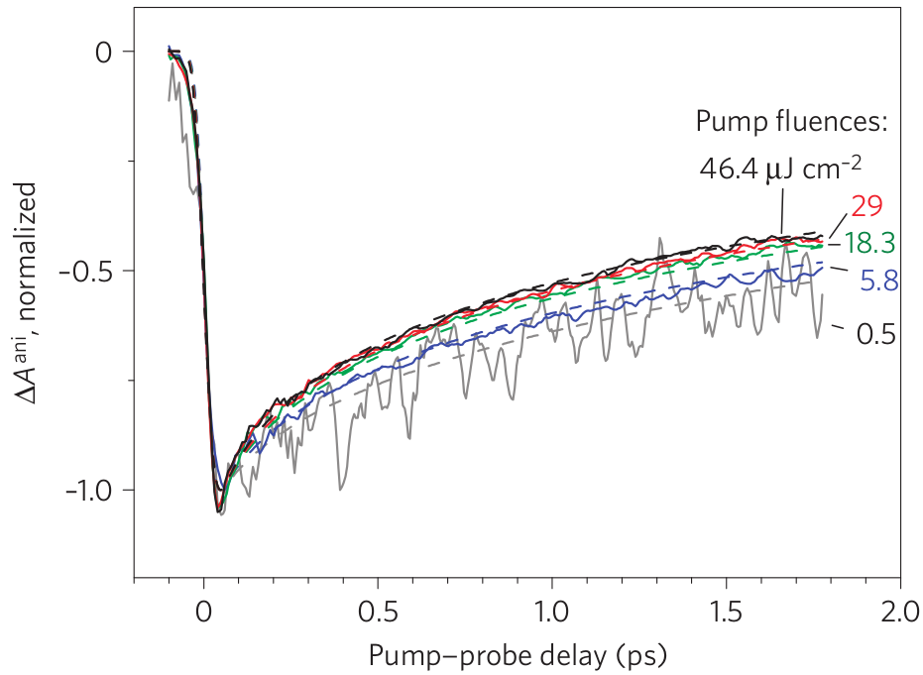
This in some ways is related to other questions regarding the rate at which exciton-exciton annihilation occurs.

Slide 30
Slide showing where we pumped and where we probed the samples.

Slide 31
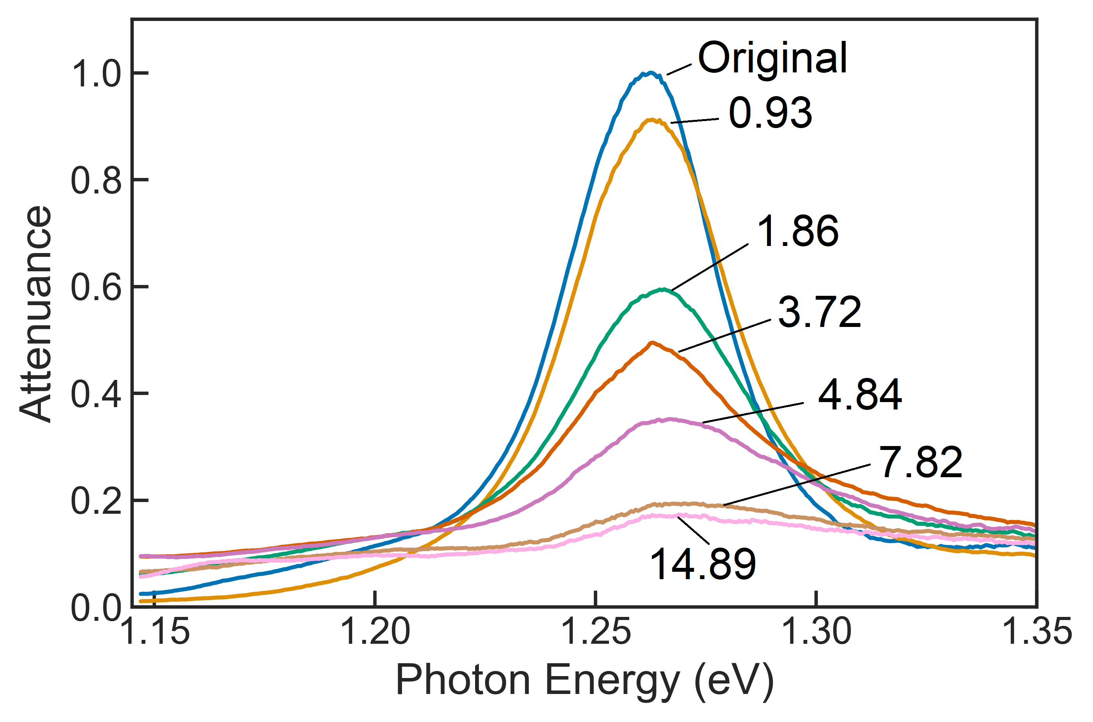
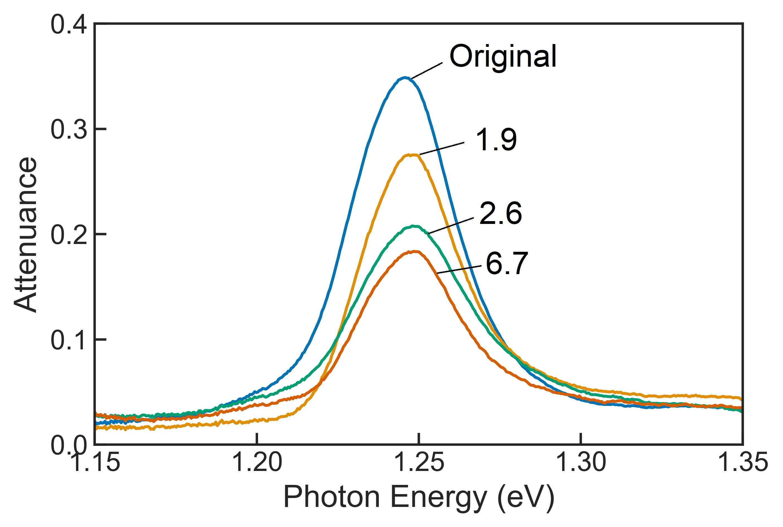

Slide 32
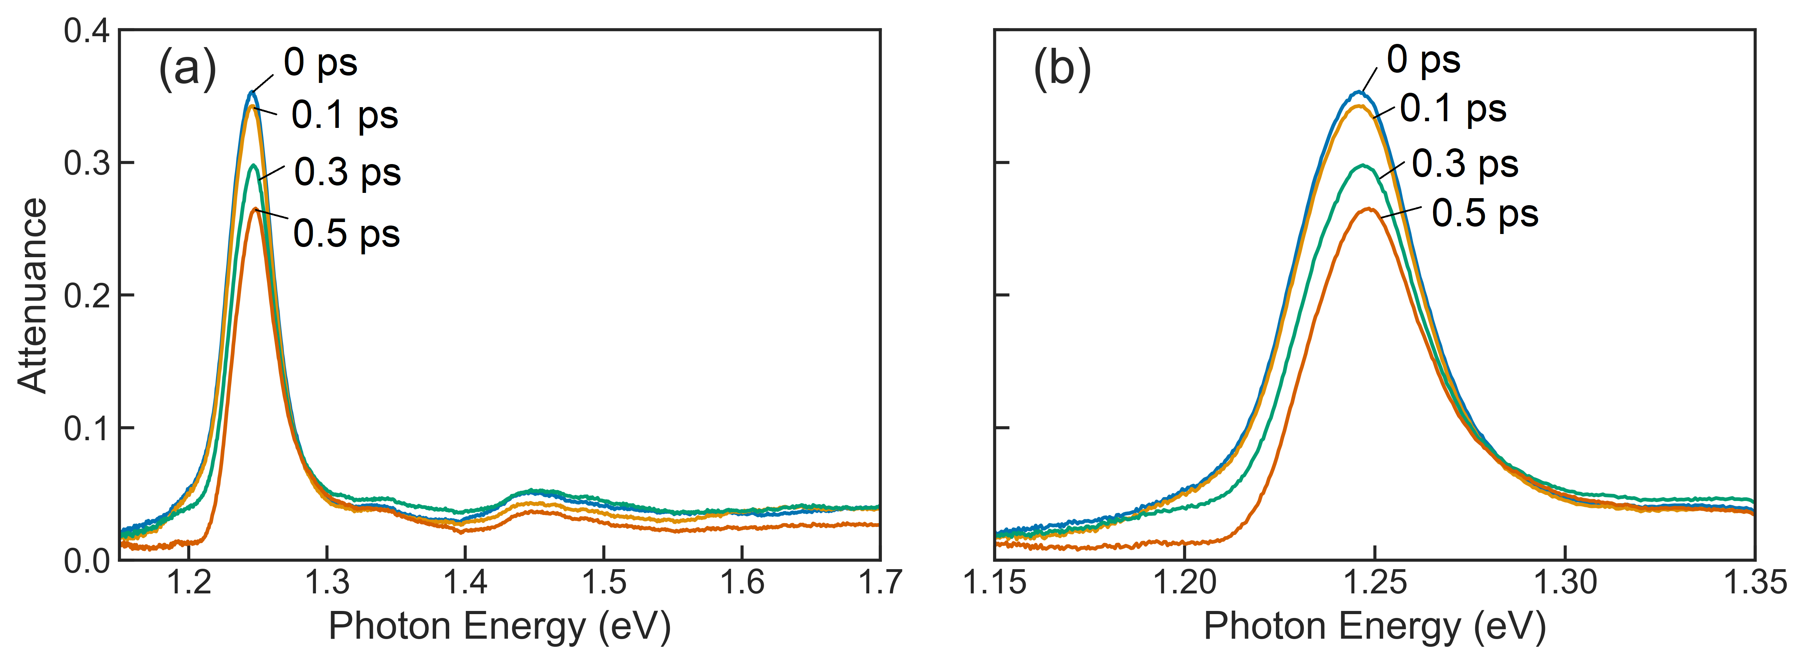

Slide 33
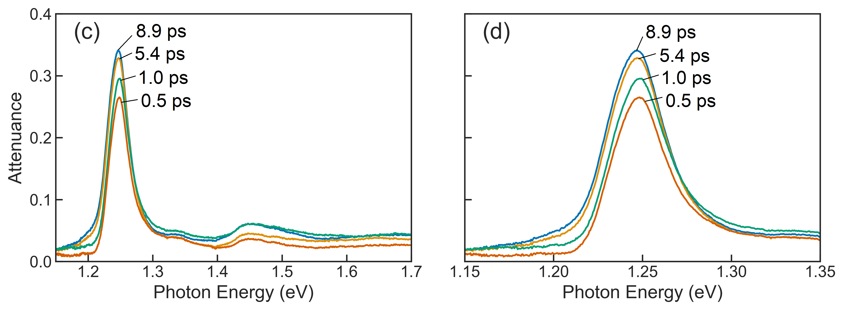

Slide 35
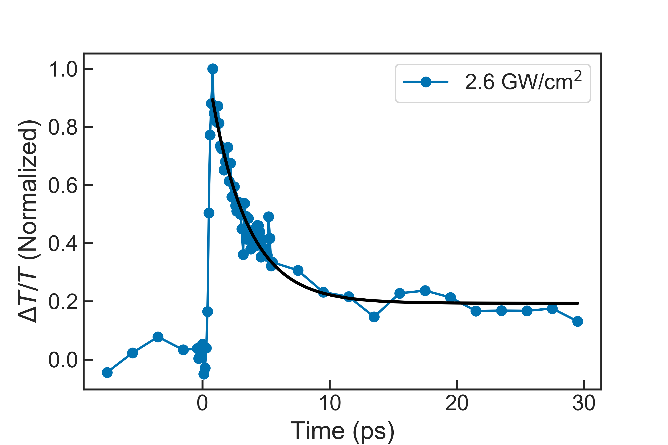
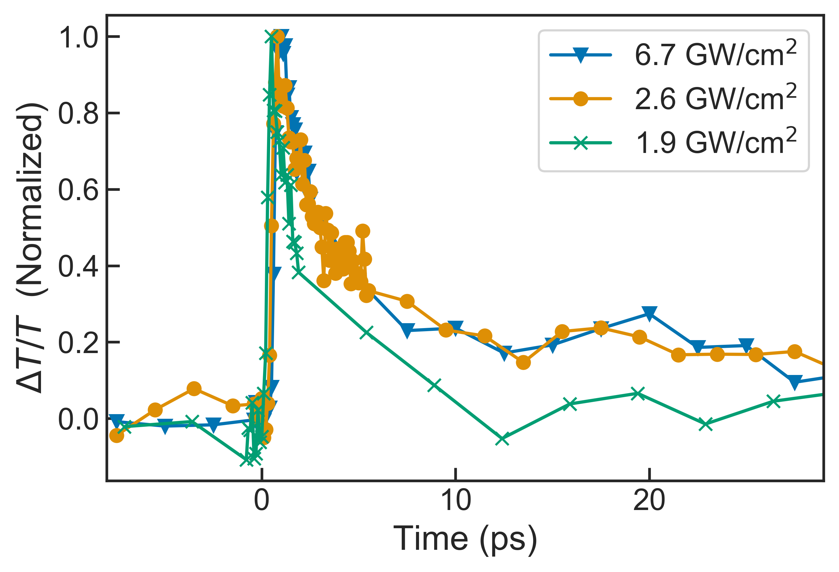

Slide 37
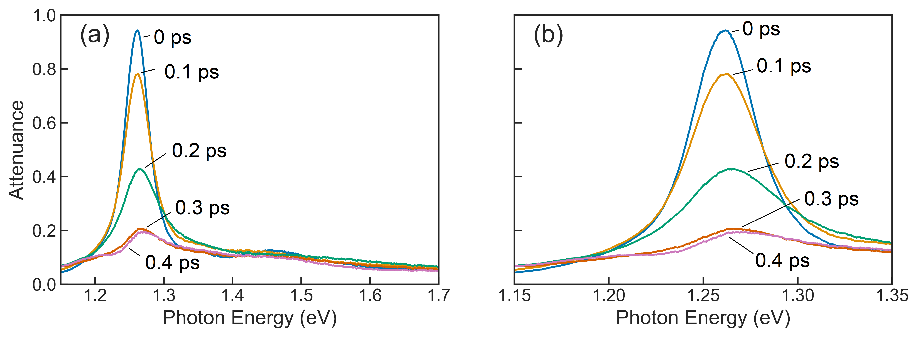

Slide 38
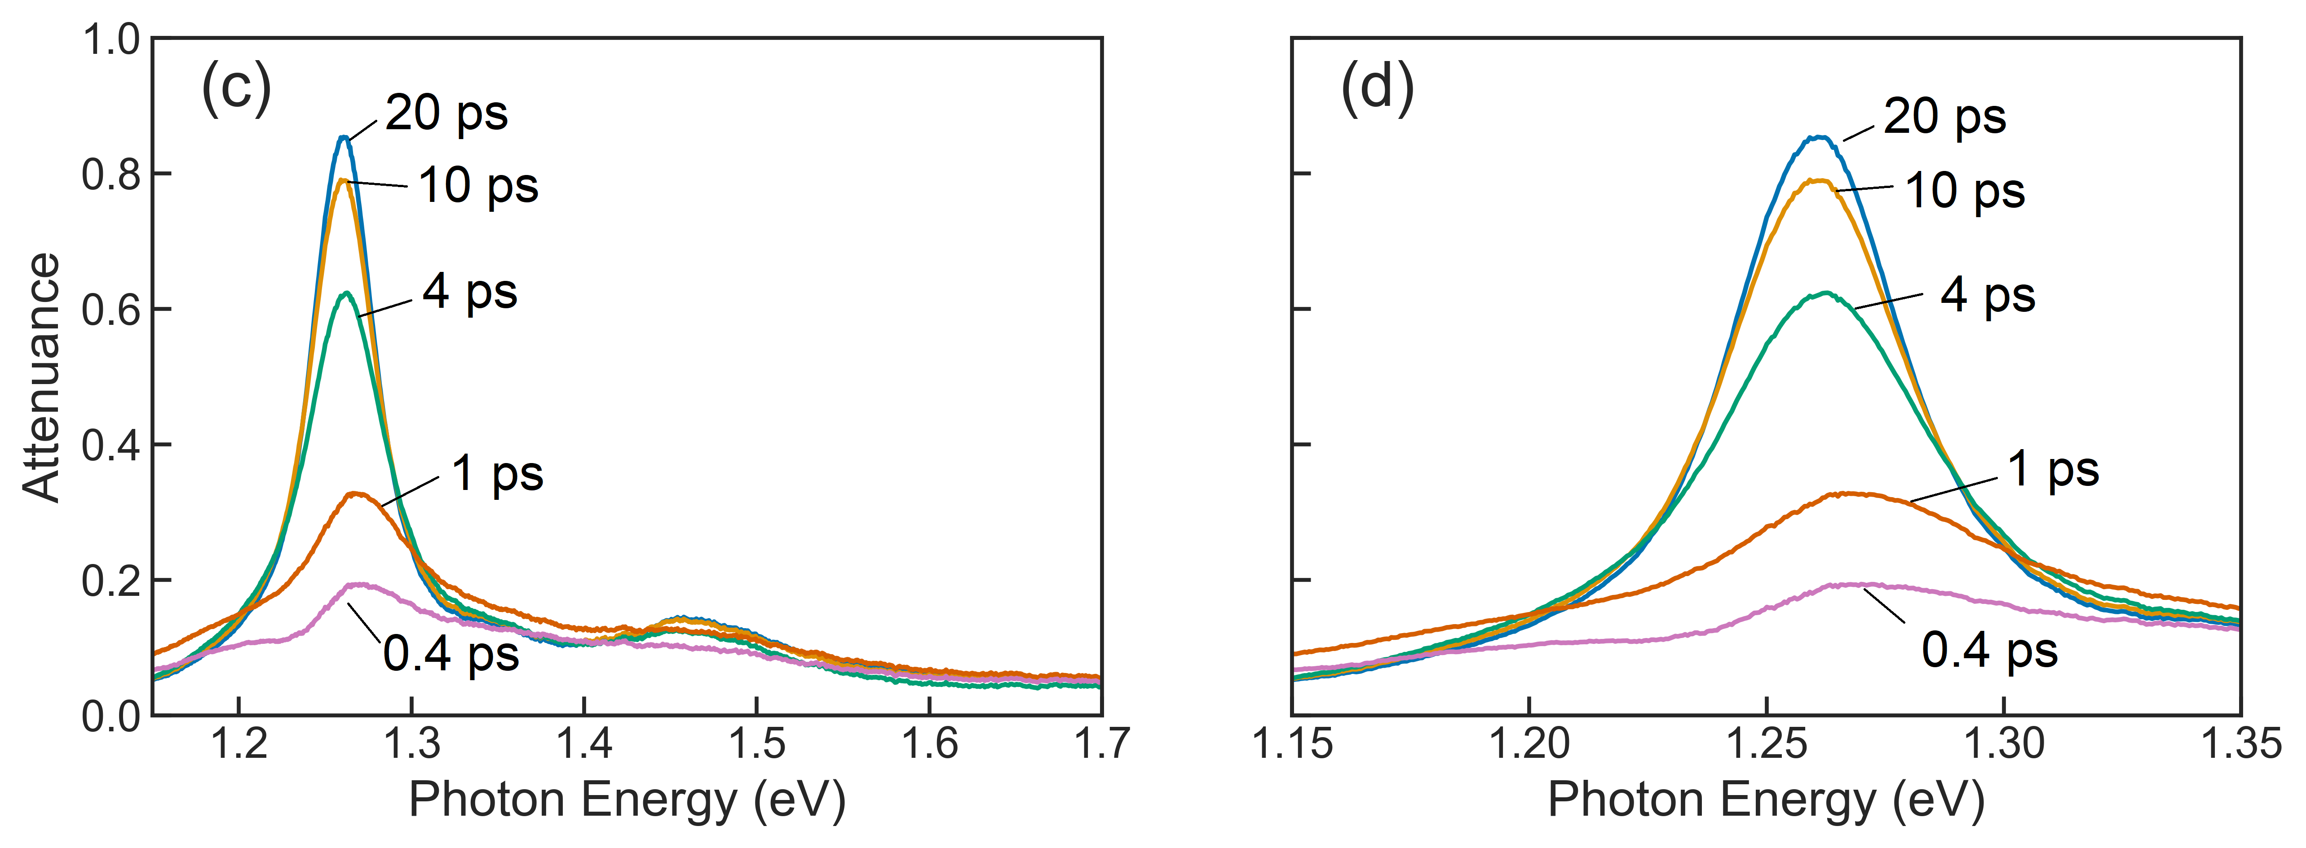

Slide 39
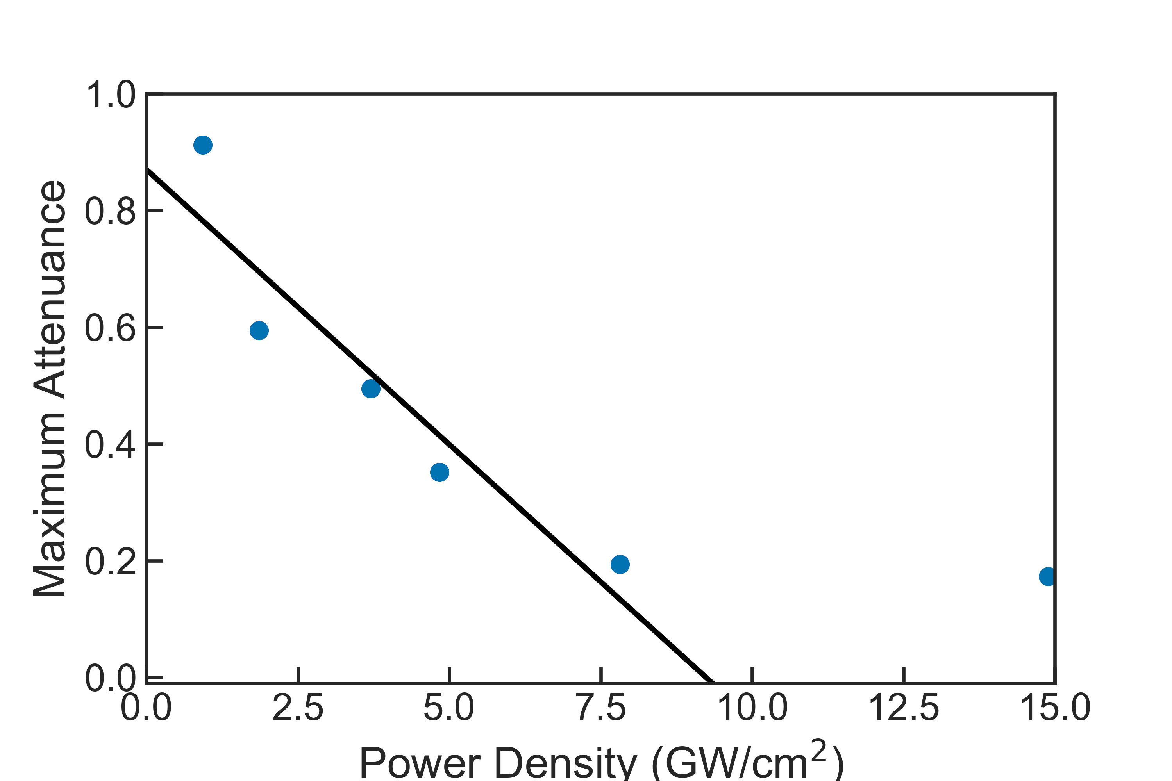

Slide 40
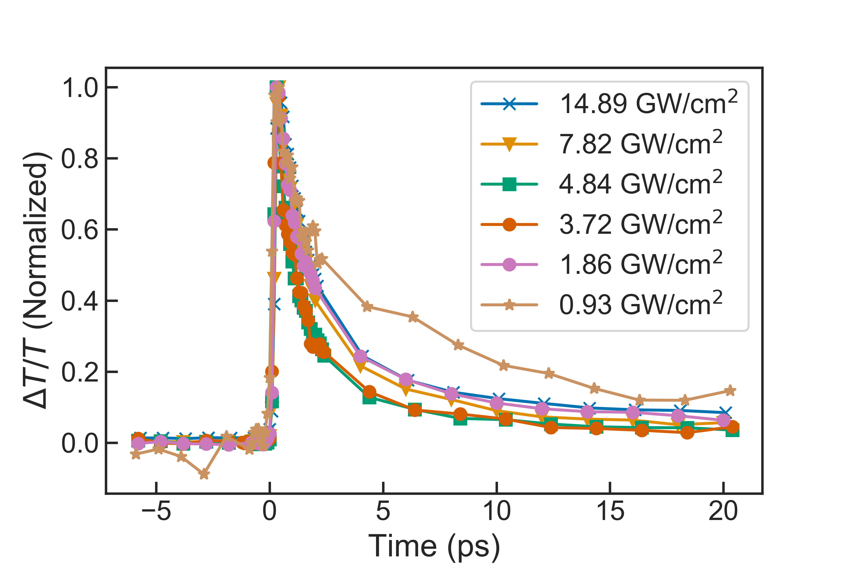
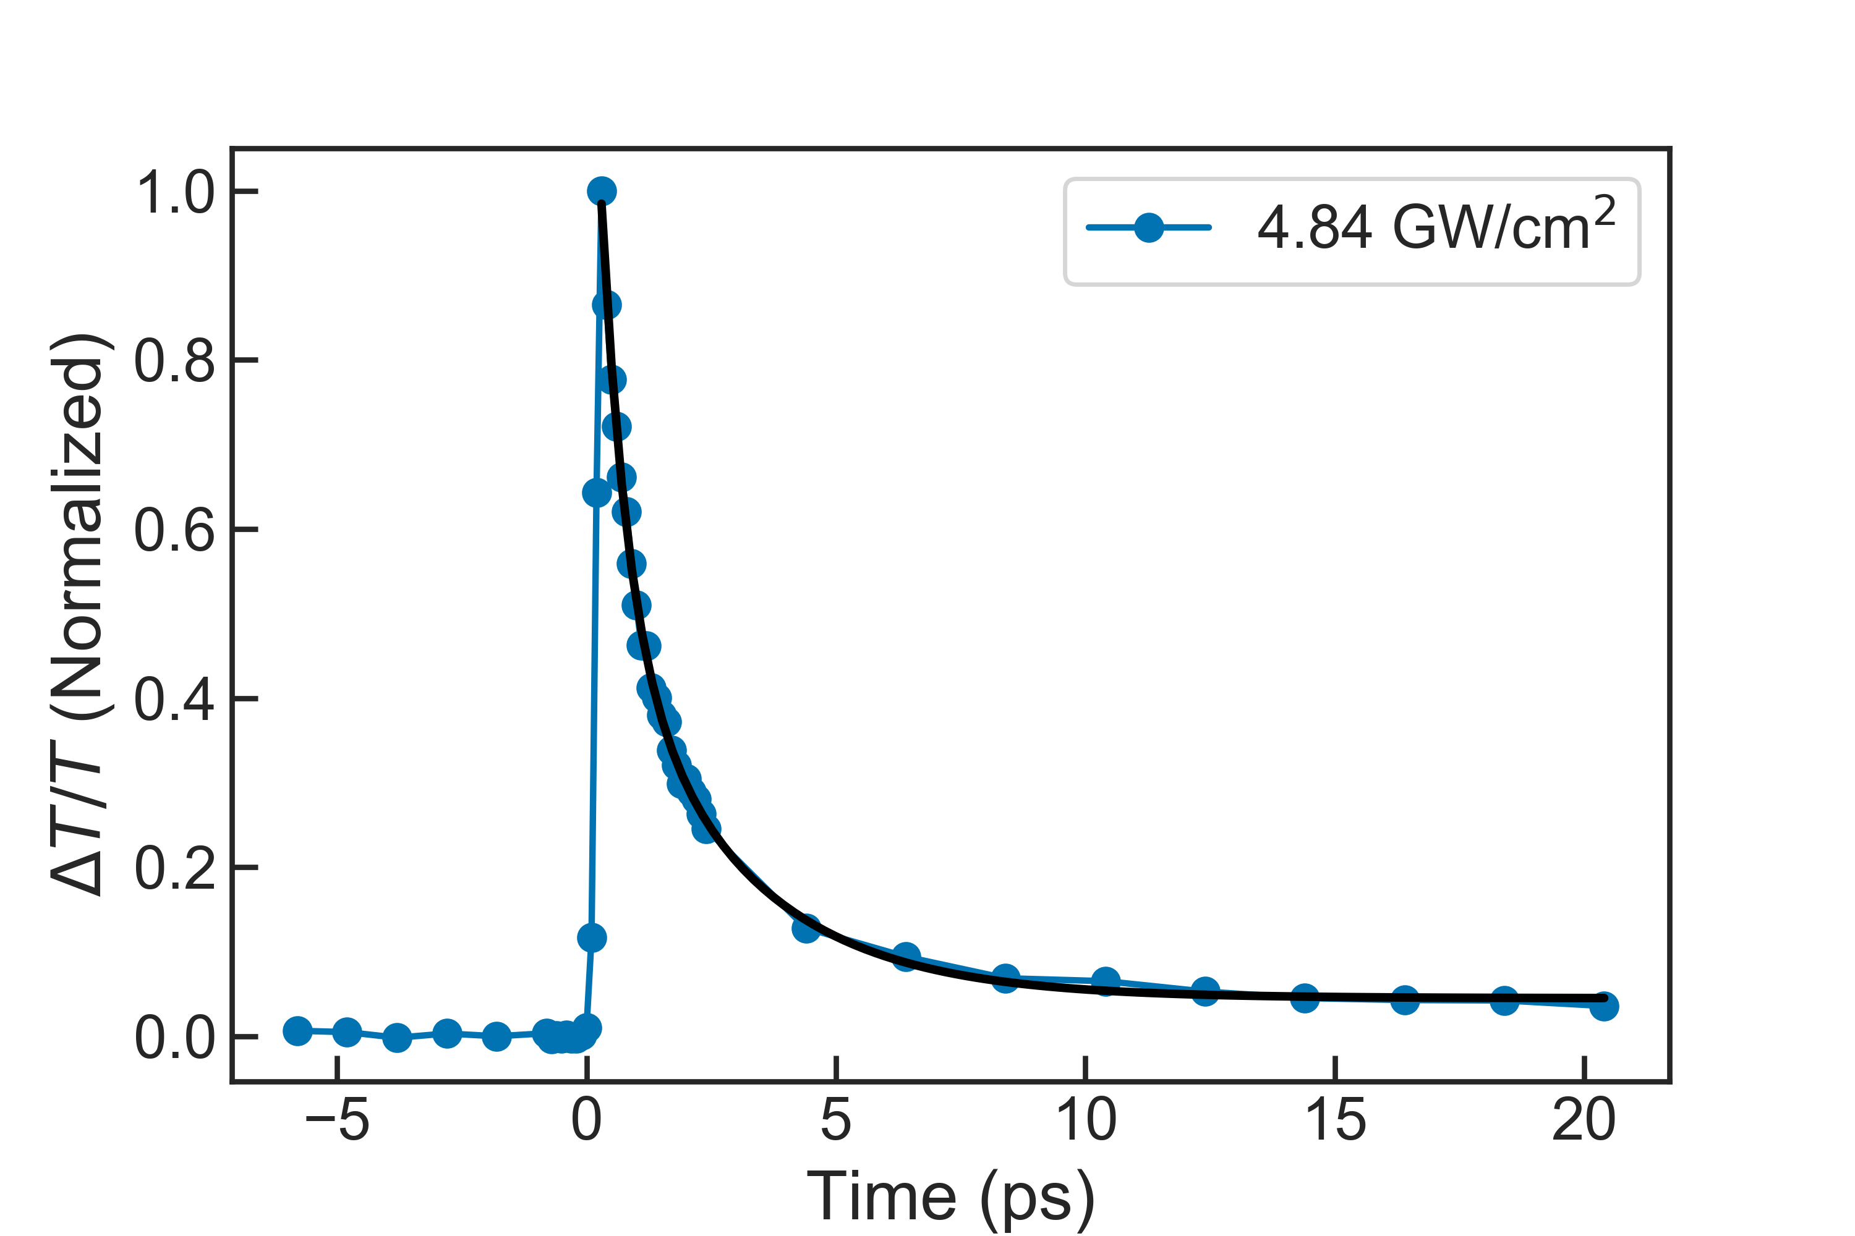

Slide 41
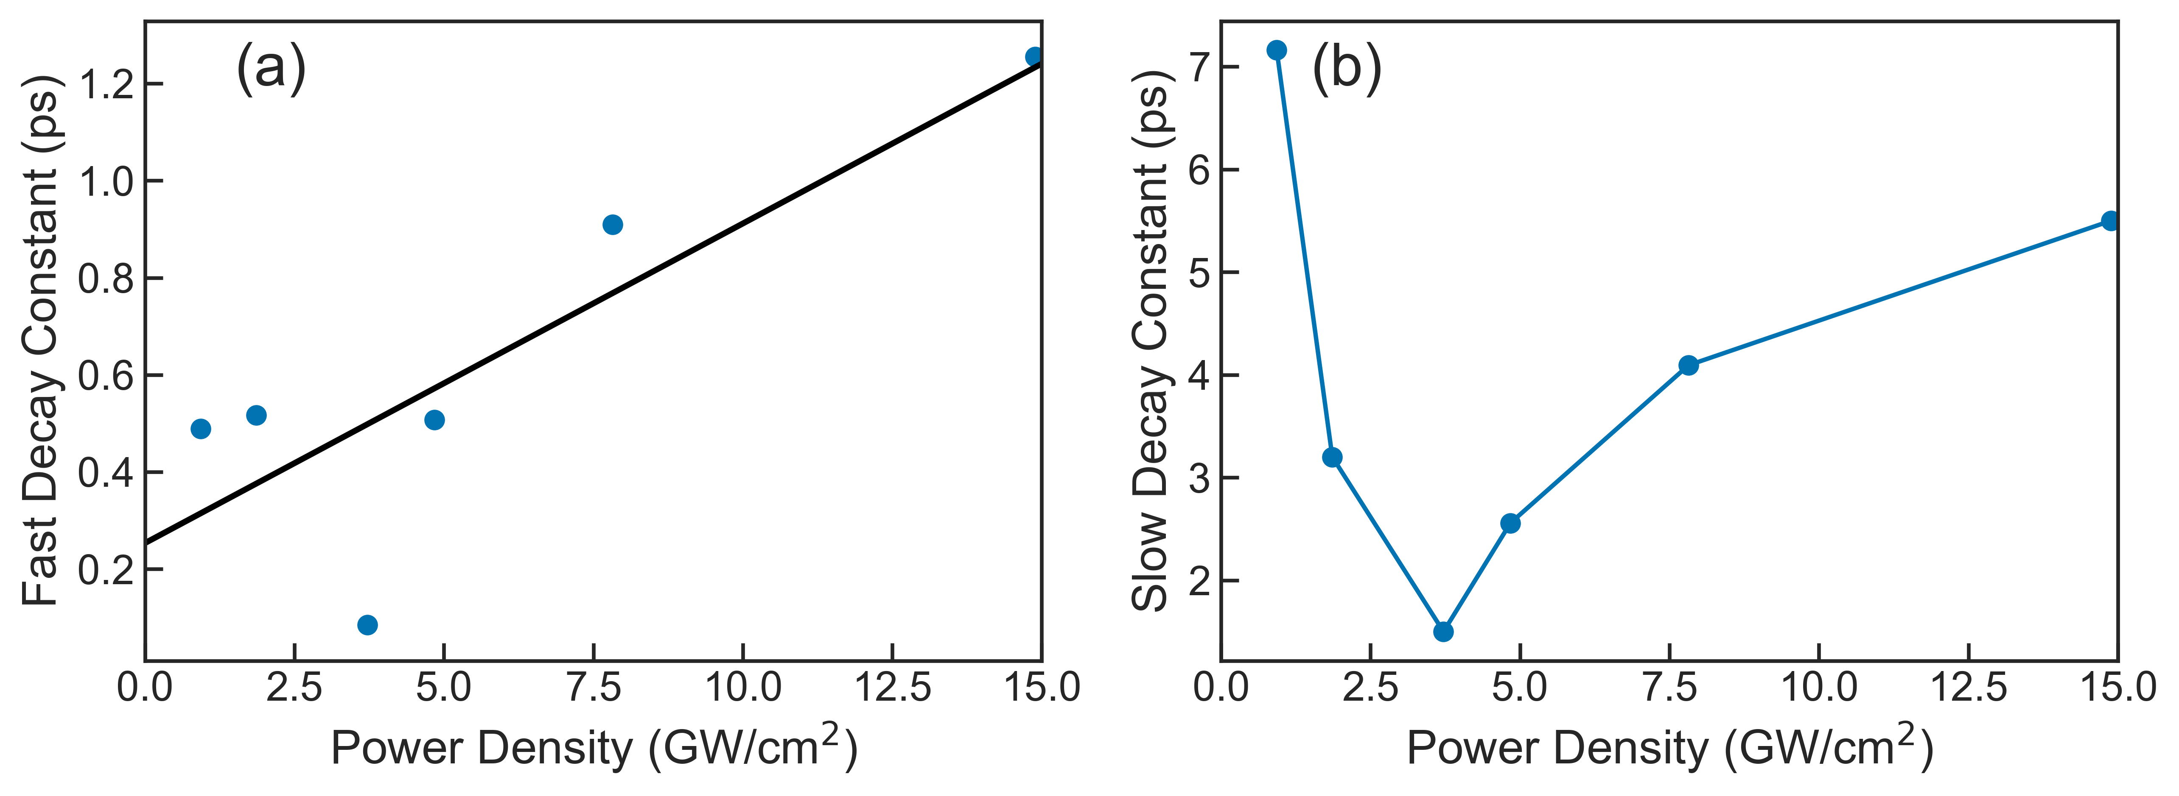

Slide 42
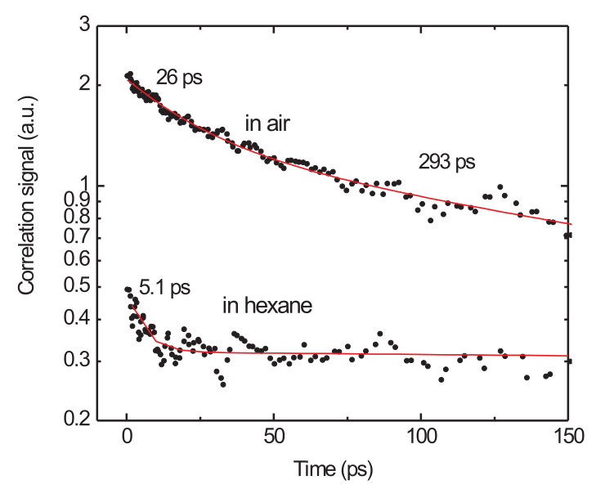

Slide 45
Summary

Slide 46
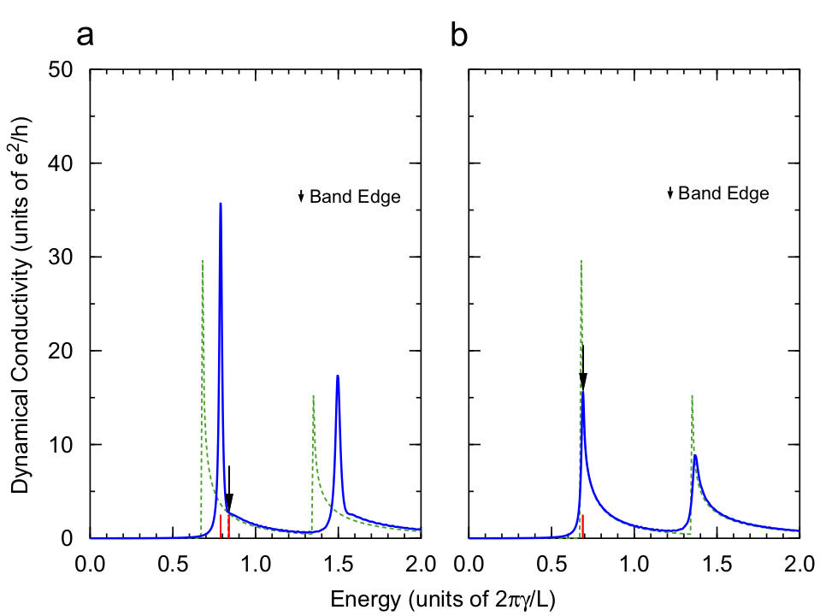

Slide 47
